Slide 1
A Systematic Mapping Study on Research in Anemia Assessment with Non-Invasive Devices
Link to the paper

Slide 2
AIM
Methodology
the analysis of the area of interest explored in the non-invasive estimate of anemia (NEA) literature,
the evaluation of the peculiarities of papers, giving special consideration to empirical ones,
examining the papers from the point of view of the daily improvement of doctors and healthcare personnel activities and the daily life of patients
the identification of any considerable research gap to encourage further investigations on new topics
The systematic mapping study has been elected as the optimal approach to probe the NEA literature since it defines a rigorous process for data retrieving and interpretation.

Slide 3
Research Questions
Question | Motivation
What is the temporal and geographical distribution of the papers? | To understand how papers develop over time and how they are distributed across countries interested in non-invasive technologies for anemia assessments
What are the topics of interest and with what frequency have they been investigated? | To discern the topics that stimulate researchers.
What are the most frequent aims of the papers? | To understand why these studies are conducted and to reflect on their utility in improving anemia assessments.
What solutions are presented in the publications? | To understand the relevance of the research in the literature and the extent to which stakeholders can use it.

Slide 4
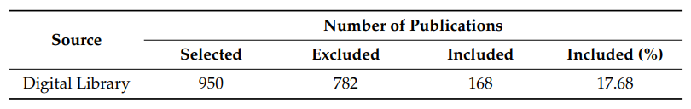
Research String
Period Examination
Search Engines Used
“improving anemia assessment”, “non-invasive anemia estimation”, “non-invasive hemoglobin measurement”
The period examined for the search string validation goes from December 2019 to April 2020
Scopus (https://www.scopus.com/); Web of Science (http://www.webofknowledge.com/WOS); Google Scholar (https://scholar.google.com/)
Journal Papers, technical reports, and conference publications from January 2014 to April 2020 from all languages (not on English) were considered

Slide 5
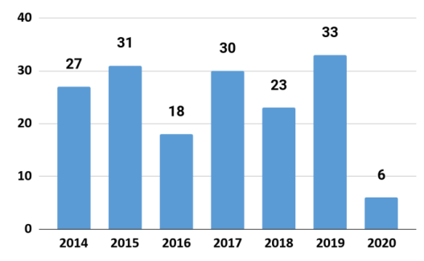
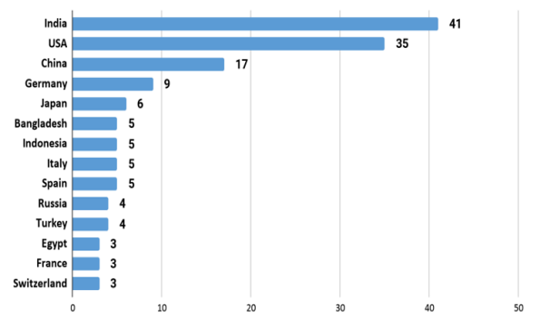
Results
Left - Papers distribution by year Right - Top productive countries
The left graph indicates that the total number of researches relative to non-invasively estimating anemia seems to remain approximately stable over the years
Right Graph highlights a trend that varies from area to area, and seems to be increasing in the most populated countries and fast-growing economies

Slide 6
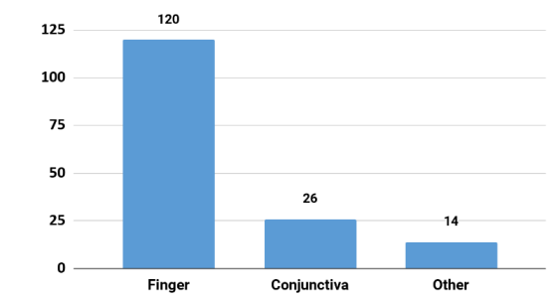
Results
Region of the body investigated in published papers

Slide 7
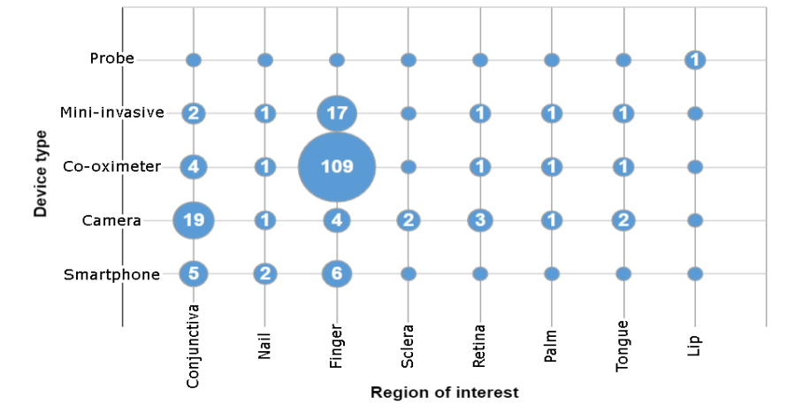
Results
The great majority of the papers investigate different regions of interest and different types of non-invasive devices.
The most discussed device is the co-oximeter and the finger as ROI
Camera devices follow and are used to examine different ROIs, but the conjunctiva seems to be the most promising one among the others.

Slide 8
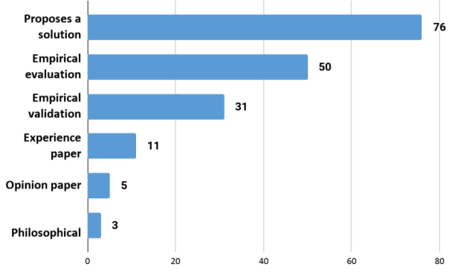
Results
There is a predominance of papers that propose a solution, followed by a good number of empirical evaluations and validations
This suggests that that the majority of the researchers are trying to find and evaluate new solutions and technologies to further improve the anemia
assessment

Slide 9
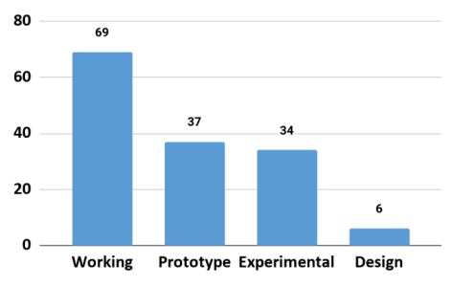
Results
Working → Technologies are beyond the state of experimentation
Prototype → These papers present tools already implemented and validated with toy examples
Experimental → They offer empirically validated solutions, often accompanied by a working prototype
Design → Proposals of technologies based only on a theoretical basis

Slide 10
Conclusion
From an initial group of 950 papers, a total of 168 were selected for this mapping study. The chosen papers allowed the authors to discuss the state of the art in the field of Estimating anemia non-invasively and to identify research gaps
The most common solution is to use light absorption and reflection properties through co-oximeters
Another solution discussed by a considerable number of papers is to use a digital camera to take photos or small videos to a body part (conjunctiva, retina, sclera, fingernail) to later analyze it and provide information to the user
An alternative to the camera solutions is smartphone-based, which have the great advantage of local analysis of the taken photo that quickens the diagnosis process

